Slide 1

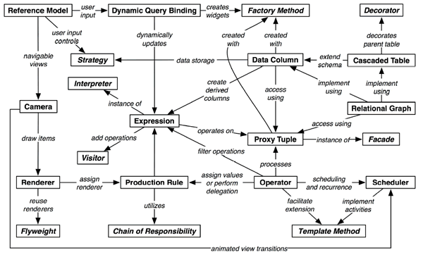
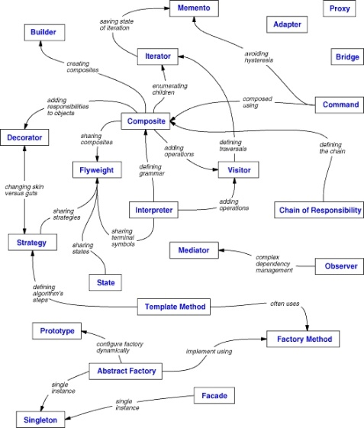
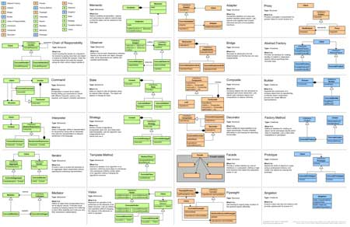
Design Patterns
General and reusable solutions to common problems in software design
Nikolay Kostov
Senior Software Developer and Technical Trainer
http://Nikolay.IT
Telerik Software Academy
academy.telerik.com

Slide 2


Table of Contents
What is a Design Pattern?
Why Design Patterns?
Types of Design Patterns
Creational patterns
Structural patterns
Behavioral patterns
Architectural Patterns
Other Patterns

Slide 3



What is a Design Pattern?
Name, Problem, Solution and Consequences

Slide 4
What Design Patterns Are?
General and reusable solutions to common problems in software design
Problem/solution pairs within a given context
Not a finished solution
A template or recipe for solving certain problems
With names to identify and talk about them

Slide 5
What Design Patterns Are? (2)
Patterns deal with
Application and system design
Abstractions on top of code
Relationships between classes or other collaborators
Problems that have already been solved
Patterns are not concerned with
Algorithms
Specific implementation classes

Slide 6

Origins of Design Patterns
“Each pattern describes a problem which occurs over and over again in our environment and then describes the core of the solution to that problem, in such a way that you can use this solution a million times over, without ever doing it in the same way twice”.
Christopher Alexander
Very successful architect
A Pattern Language: Towns, Buildings, Construction, 1977
Context:
City Planning and Building architectures

Slide 7
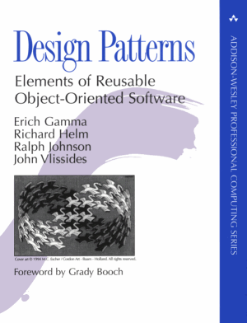
Origins of Design Patterns (2)
Search for recurring successful designs
Emergent designs from practice
Supporting higher levels of design reuse is quite challenging
Described in Gama, Helm, Johnson, Vlissides 1995 (i.e., “Gang of Four Book”)
Based on work by Christopher Alexander
An Architect on building homes, buildings and towns

Slide 8
Describing Design Patterns
Graphical notation is generally not sufficient
In order to reuse design decisions the alternatives and trade-offs that led to the decisions are critical knowledge
Concrete examples are also important
The history of the why, when, and how set the stage for the context of usage
Collaborations
Structure
Pattern name
Motivation
Participants
Known Uses
Applicability
Intent
Also Known As
Consequences
Implementation
Sample Code
Related Patterns

Slide 9
Elements of Design Patterns
Design patterns have four essential elements:
Pattern Name
Increases vocabulary of designers
Problem
Intent, context, when to apply
Solution
UML-like structure, abstract code
Consequences
Results and tradeoffs

Slide 10
Pattern Name
Used to describe:
A design problem
Its solutions
Its consequences
Increases design vocabulary
Design at a higher level of abstraction
Enhances communication
“The hardest part of programming is coming up with good variable names”

Slide 11

Problem
Describes when to apply the pattern
Explains the problem and its context
May describe specific design problems and/or object structures
May contain a list of preconditions that must be met before it makes sense to apply the pattern

Slide 12

Solution
Describes the elements that make up the
Design
Relationships
Responsibilities
Collaborations
Does not describe specific concrete implementation
Abstract description of design problems and how the pattern solves it

Slide 13
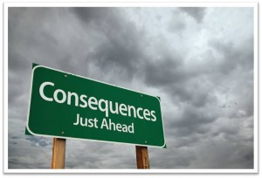
Consequences
Results and trade-offs of applying the pattern
Critical for:
Evaluating design alternatives
Understanding costs
Understanding benefits
Includes the impacts of a pattern on a system’s:
Flexibility, Extensibility, Portability

Slide 14
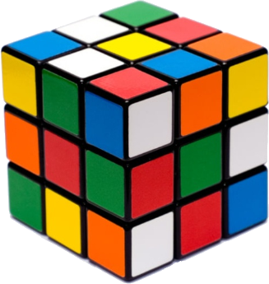
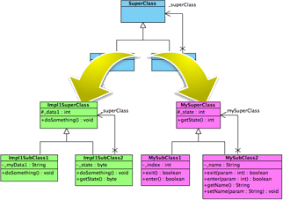
Why Design Patterns?

Slide 15
Benefits of Design Patterns
Design patterns enable large-scale reuse of software architectures
Help document how systems work
Patterns explicitly capture expert knowledge and design trade-offs
Patterns help improve developer communication (shared language)
Pattern names form a common vocabulary
Patterns help ease the transition to OO technology

Slide 16
When to Use Patterns?
Solutions to problems that recur with variations
No need for reuse if problem only arises in one context
Solutions that require several steps:
Not all problems need all steps
Patterns can be overkill if solution is a simple linear set of instructions!
Do not use patterns when not required
Overdesign is evil!

Slide 17
Drawbacks of Design Patterns
Patterns do not lead to a direct code reuse
Patterns are deceptively simple
Teams may suffer from pattern overload
Patterns are validated by experience and discussion rather than by automated testing
Integrating patterns into the software development process is a human-intensive activity
Use patterns if you understand them well

Slide 18
Criticism of Design Patterns
Targets the wrong problem
The design patterns may just be a sign of some missing features of a given programming language
Lacks formal foundations
The study of design patterns has been excessively ad-hoc
Leads to inefficient solutions
Does not differ significantly from other abstractions

Slide 19
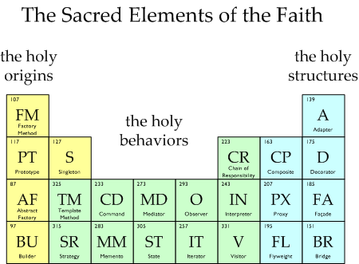
Types of Design Patterns

Slide 20
Three Main Types of Patterns
Creational patterns
Deal with initializing and configuring classes and objects
Structural patterns
Describe ways to assemble objects to implement a new functionality
Composition of classes or objects
Behavioral patterns
Deal with dynamic interactions among societies of classes and objects
How they distribute responsibility

Slide 21
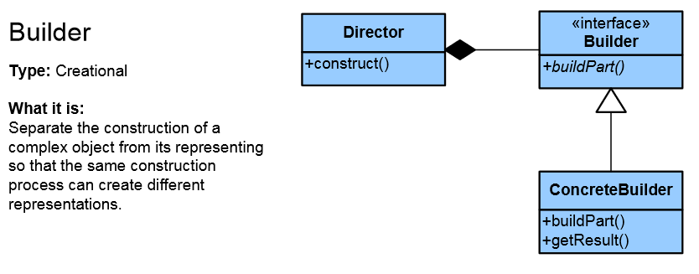
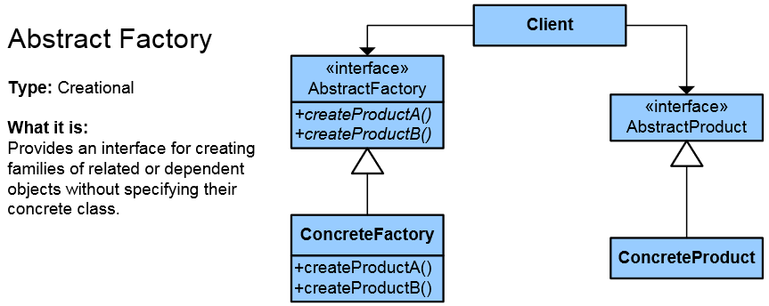
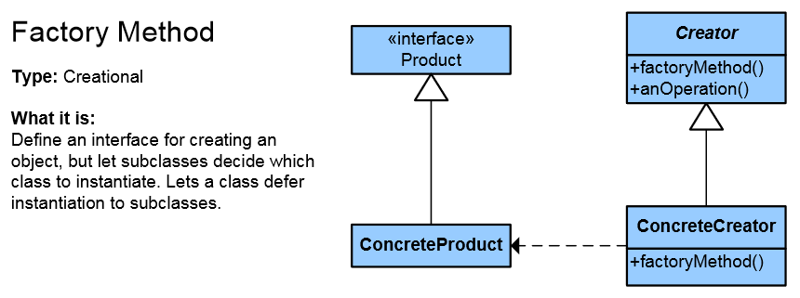
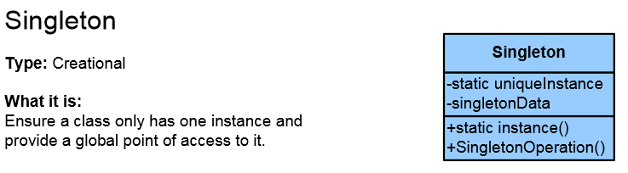
Creational Patterns

Slide 22
Creational Patterns
Deal with object creation mechanisms
Trying to create objects in a manner suitable to the situation
Composed of two dominant ideas
Encapsulating knowledge about which concrete classes the system uses
Hiding how instances of these concrete classes are created and combined

Slide 23
Singleton
Singleton is the most often used design pattern
The Singleton class is a class that is supposed to have only one (single) instance
Sometimes Singleton is wrongly thought of as a global variable – it is not!
Possible problems:
Lazy loading
Thread-safe

Slide 24
Double-Check / Lock Singleton Implementation
public sealed class Log
{
private static Log instance;
private Log() {}
public static Log Instance
{
get
{
if (instance == null)
{
lock (instance)
{
if (instance == null)
instance = new Log();
}
}
return instance;
}
}
}

Slide 25
Simple Factory
This is not a Pattern
Often mistaken with the Factory Pattern
It is used quite often
This is the preparation for the real Pattern
Export the object creation in one place
If we making changes, we make them in one place
We can hide complex object creation
Higher level of abstraction

Slide 26
Simple Factory – Example
public class PizzaFactory
{
public Pizza CreatePizza(PizzaType pizzaType)
{
Pizza pizza = null;
switch (pizzaType)
{
case PizzaType.Cheese:
{ return new CheesePizza(); }
case PizzaType.Pepperoni:
{ return new PepperoniPizza(); }
case PizzaType.Hawai:
{ return new HawaiPizza(); }
default:
{ return null; }
}
return pizza;
}
}

Slide 27
Factory Method
Objects are created by separate method
Produces objects as normal Factory
This allows achieving higher reusability and flexibility in the changing applications

Slide 28
Factory Method – Example
abstract class Document
{
private List<Page> _pages = new List<Page>();
public Document() { this.CreatePages(); }
public List<Page> Pages { get { return _pages; } }
public abstract void CreatePages();
}
class CV : Document
{
public override void CreatePages() {
Pages.Add(new SkillsPage(), new BioPage()); // ...
}
}
class Report : Document
{
public override void CreatePages() {
Pages.Add(new ResultsPage, SummaryPage()); // ...
}
}

Slide 29
Abstract Factory
Abstraction in object creation
Create a family of related objects
The Abstract Factory Pattern defines interface for creating sets of linked objects
Without knowing their concrete classes
Used in systems that are frequently changed
Provides flexible mechanism for replacement of different sets
Notes:
Множество – йерархия, библиотека от класове, някаква съвкупност от свързани, зависими обекти
Множеството може ли да е само един обект?

Slide 30
Abstract Factory – Example
abstract class ContinentFactory { // AbstractFactory
public abstract Herbivore CreateHerbivore();
public abstract Carnivore CreateCarnivore();
}
class AfricaFactory : ContinentFactory {
public override Herbivore CreateHerbivore() {
return new Wildebeest();
}
public override Carnivore CreateCarnivore() {
return new Lion();
}
}
class AmericaFactory : ContinentFactory {
public override Herbivore CreateHerbivore() {
return new Bison();
}
public override Carnivore CreateCarnivore() {
return new Wolf();
}
}

Slide 31
The Builder Pattern
Separates the construction of a complex object from its representation so that the same construction process can create different representations
Separation of logic and data
Solves 3 types of problems
Too many parameters
Order dependent
Different constructions

Slide 32
The Builder Pattern (2)
Builder is used by Director
Builder is implemented by a concrete builder
Product is produced by the concrete builder
Put the steps in the right order
Director
Defines the implementation
Define the steps
Builder
Concrete Builder
Product

Slide 33
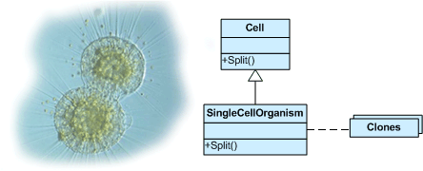
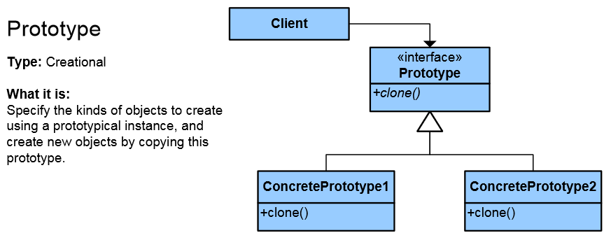
Prototype Pattern
Factory for cloning new instances from a prototype
Create new objects by copying this prototype
Instead of using "new" keyword
ICloneable interface acts as Prototype

Slide 34
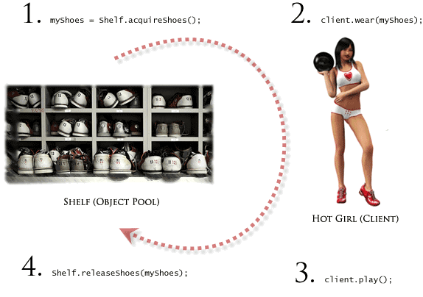

Other Creational Patterns
Object Pool
Avoid expensive acquisition and release of resources by recycling unused objects
Lazy initialization
Tactic of delaying the creation of an object, the calculation of a value, or some other expensive process until the first time it is needed

Slide 35
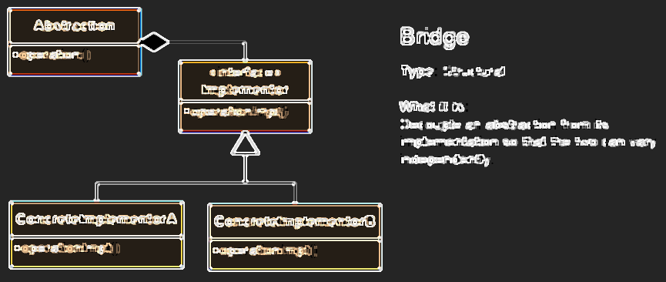
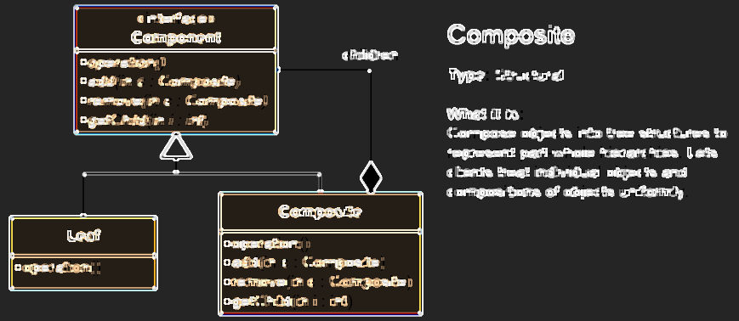
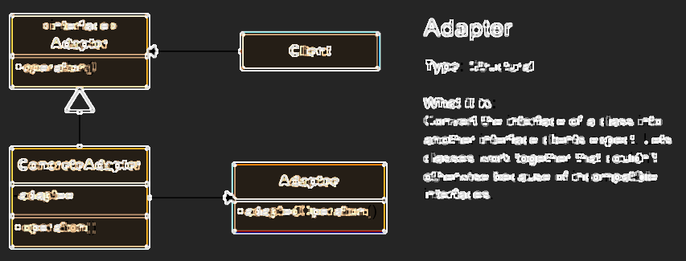
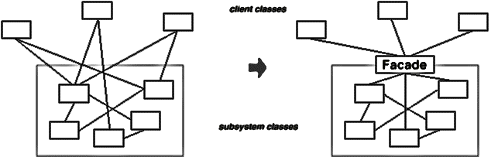
Structural Patterns

Slide 36
Structural Patterns
Describe ways to assemble objects to implement a new functionality
Ease the design by identifying a simple way to realize relationships between entities
This design patterns is all about Class and Object composition
Structural class-creation patterns use inheritance to compose interfaces
Structural object-patterns define ways to compose objects to obtain new functionality

Slide 37
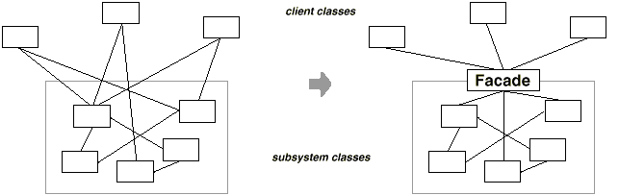
Facade Pattern
To deliver convenient interface from higher level to group of subsystems or single complex subsystem
Façade pattern used in many Win32 API based classes to hide Win32 complexity

Slide 38
Facade – Real World Example
The hard way:
popper.On();
popper.Pop();
amp.On();
amp.SetSurroundSound();
amp.SetVolume(10);
amp.SetDvd(dvd);
screen.Down();
lights.Dimm(20);
projector.On();
projector.WideScreenMode();
dvd.On();
dvd.Play("Dzift");
The facade way
homeTheater.WatchMovie("Dzift");

Slide 39
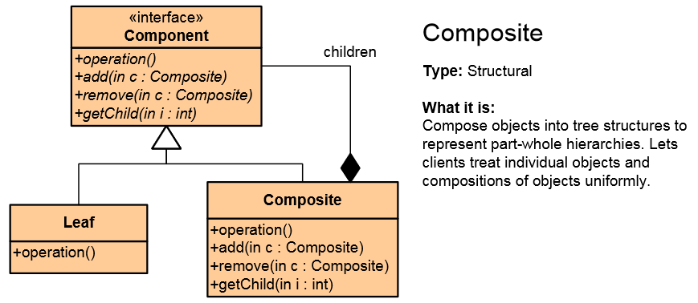
Composite Pattern
Composite Pattern allows to combine different types of objects in tree structures
Gives the possibility to treat the same individual objects or groups of objects
Used when
You have different objects and you want to treat them the same way
You want to present hierarchy of objects

Slide 40
Composite Pattern – Example
abstract class Shape {
public abstract void Draw();
}
class ConcreteShape : Shape {
public override void Draw() { /*...*/ }
}
class ComplexShape : Shape {
private List<Shape> ownedShapes;
public override void Draw() { /*...*/ }
}
class Line : Shape { public override void Draw() { ... } }
static void Main() {
var rootShape = new ComplexShape();
/* ... */
}

Slide 41
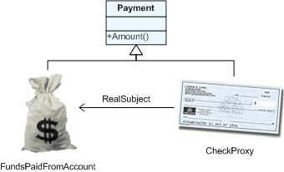
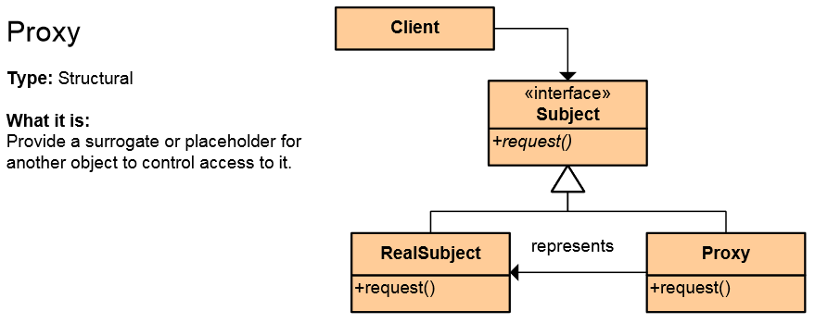
The Proxy Pattern
An object representing another object
Provide a surrogate or placeholder for another object to control access to it
Use an extra level of indirection to support distributed, controlled, or intelligent access
Add a wrapper and delegation to protect the real component from undue complexity
Example: Web Service

Slide 42
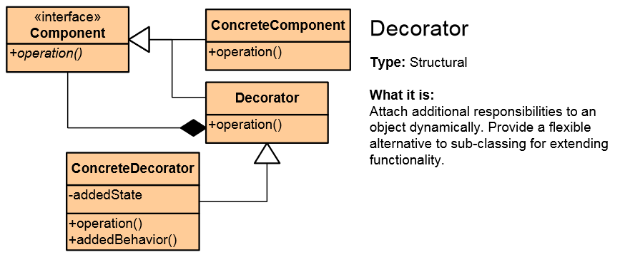
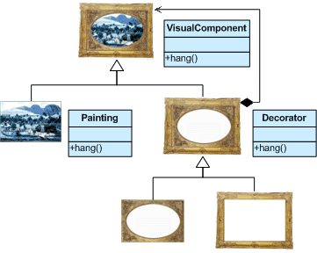
Decorator Pattern
Add responsibilities to objects dynamically
Wrapping original component
Alternative to inheritance (class explosion)
Support Open-Closed principle
In .NET: CryptoStream decorates Stream

Slide 43
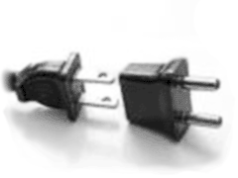
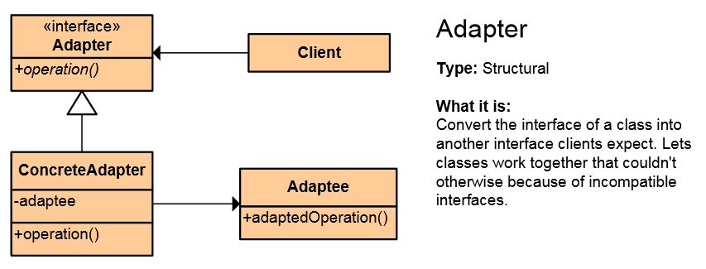
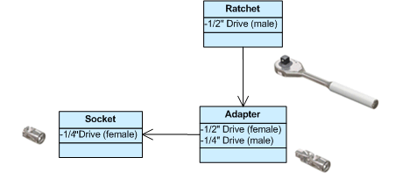
Adapter Pattern
Converts the given class' interface into another class requested by the client
Wrap an existing class with a new interface
Impedance match an old component to a new system
Allows classes to work together when this is impossible due to incompatible interfaces

Slide 44
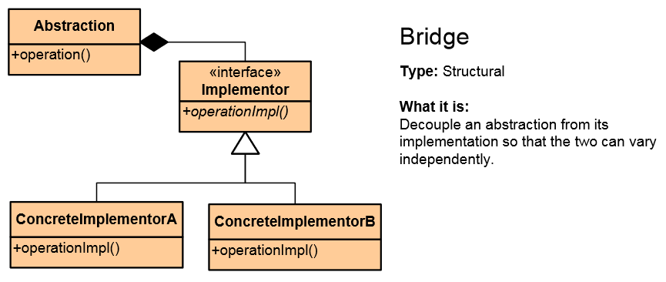

Bridge Pattern
Used to divide the abstraction and its implementation (they are by default coupled)
That way both can be rewritten independently
Solves problems usually solved by inheritance
From: Abstraction -> Implementation To: Abstraction -> Abstraction -> Implementation

Slide 45
Proxy vs. Decorator vs. Adapter vs. Bridge
Proxy – to lazy-instantiate an object, or hide the fact that you're calling a remote service, or control access to the object (one-to-one interface)
Decorator – to add functionality to an object runtime (not by extending that object's type)
Adapter – to map an abstract interface to another object which has similar functional role, but a different interface (changes interface for the client)
Bridge – define both the abstract interface and the underlying implementation. I.e. you're not adapting to some legacy or third-party code, you're the designer of all the code but you need to be able to swap out different implementations (all changeable)

Slide 46
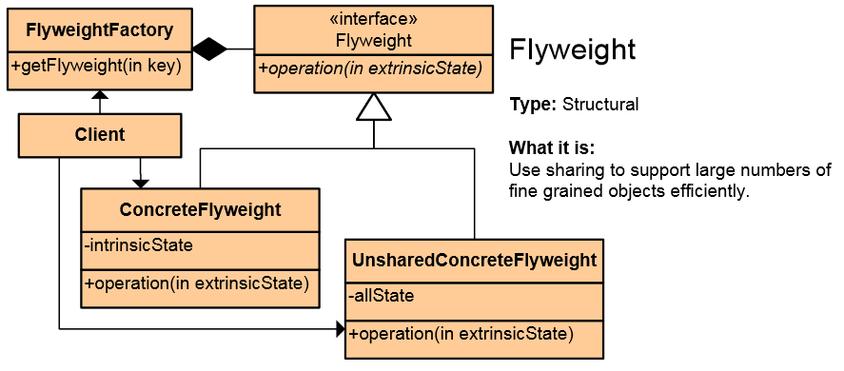
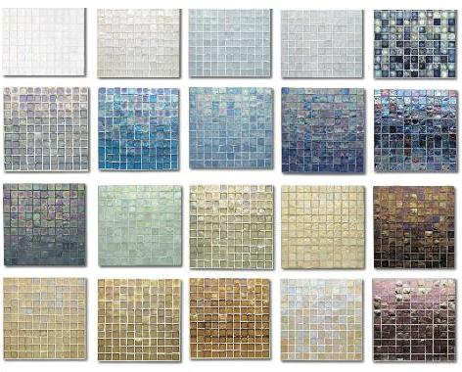
Flyweight Pattern
Use sharing to support large numbers of fine-grained objects efficiently
Reduce storage costs for large number of objects
Share objects to be used in multiple contexts simultaneously
Retain object oriented granularity and flexibility

Slide 47
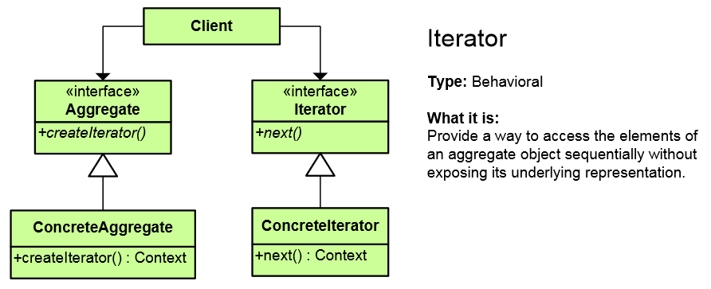
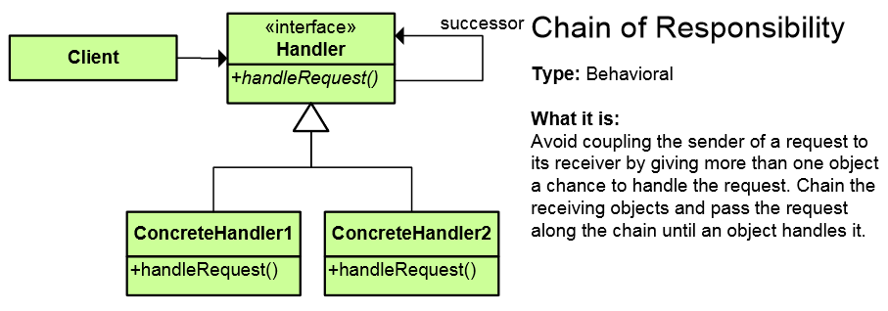
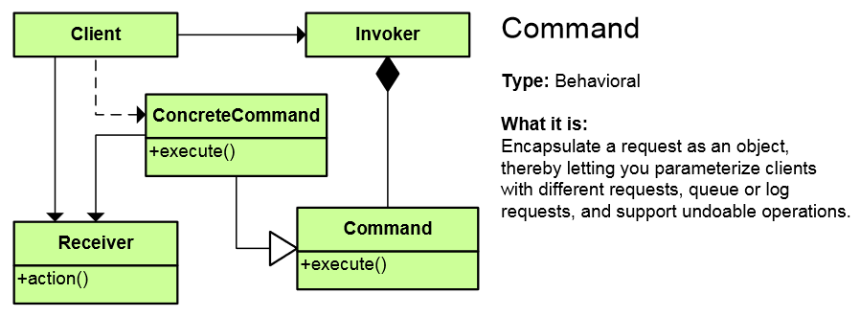
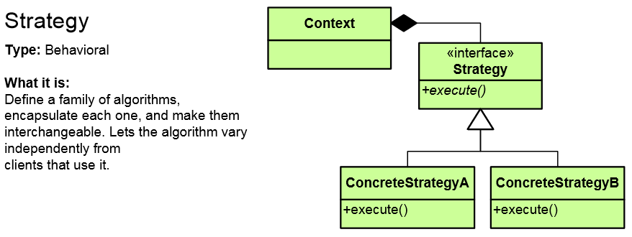
Behavioral Patterns

Slide 48
Behavioral Patterns
Concerned with communication (interaction) between the objects
Either with the assignment of responsibilities between objects
Or encapsulating behavior in an object and delegating requests to it
Increase flexibility in carrying out cross-classes communication

Slide 49
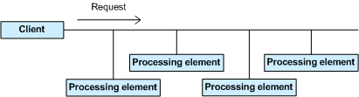
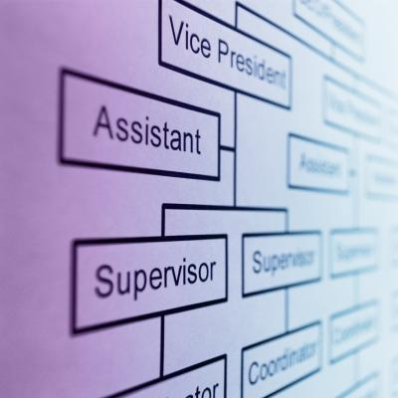
Chain of Responsibility Pattern
Allows you to pass a request to from an object to the next until the request is fulfilled
Analogous to the exception handling
Simplifies object interconnections
Each sender keeps a single reference to the next

Slide 50
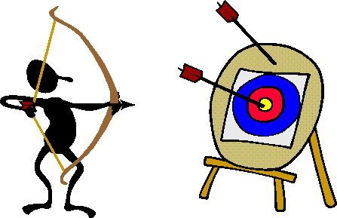
Iterator Pattern
Access to the elements of a complex object without revealing its actual presentation
Various ways of data structure traversing
Unified interface for iterating over various data structures
foreach loops in C# uses the Iterator pattern

Slide 51
Iterator – Example
public interface IEnumerator {
bool MoveNext();
object Current { get; }
void Reset();
}
public interface IEnumerable {
IEnumerator GetEnumerator();
}
private class ConcreteEnumerator : IEnumerator {
// Implement IEnumerator interface
}
var enumerator = someObject.GetEnumerator();
enumerator.Reset();
while (enumerator.MoveNext()) {
// work with enumerator.Current
}

Slide 52
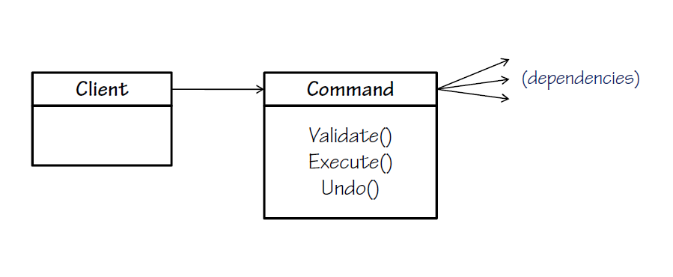
The Command Pattern
An object encapsulates all the information needed to call a method at a later time
Letting you parameterize clients with different requests, queue or log requests, and support undoable operations
Command in WPF and Silverlight encapsulate a request to call a method with parameters

Slide 53
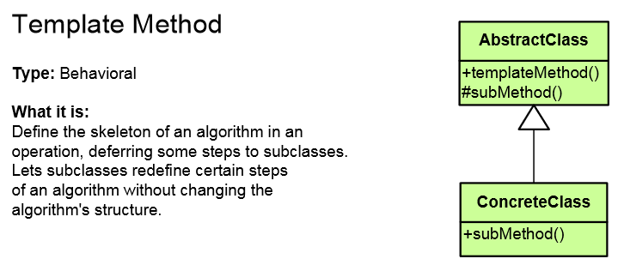
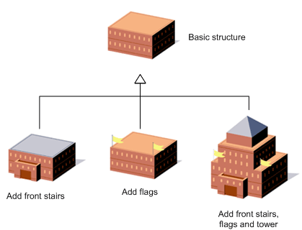
Template Method Pattern
Defines the base of an algorithm in a method, leaving some implementation to its subclasses
Template Method allows the subclasses to redefine the implementation of some of the parts of the algorithm
Doesn’t let the subclasses to change the algorithm structure

Slide 54
Template Method – Example
public abstract class HotDrink {
public void PrepareRecipe()
{
BoilWater(); Brew(); PourInCup(); AddSpices();
}
protected abstract void Brew();
protected abstract void AddSpices();
private void BoilWater() { ... }
private void PourInCup() { ... }
}
public class Coffee : HotDrink {
protected override void Brew() { ... }
protected override void AddSpices() { ... }
}
public class Tea : HotDrink {
protected override void Brew() { ... }
protected override void AddSpices() { ... }
}
Implemented by subclasses

Slide 55
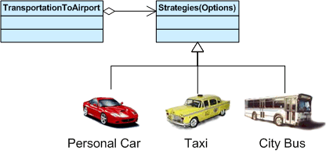
Strategy Pattern
Encapsulates an algorithm inside a class
Making each algorithm replaceable by others
All the algorithms can work with the same data transparently
The client can transparently work with each algorithm

Slide 56
Strategy Pattern – Example
abstract class SortStrategy {
public abstract void Sort(List<object> list);
}
class QuickSort : SortStrategy {
public override void Sort(ArrayList list) { /* ... */ }
}
class MergeSort : SortStrategy {
public override void Sort(ArrayList list) { /* ... */ }
}
class SortedList {
private List<object> list = new List<object>();
public void Sort(SortStrategy strategy) {
// sortStrategy can be passed in constructor
sortStrategy.Sort(list);
}
}

Slide 57
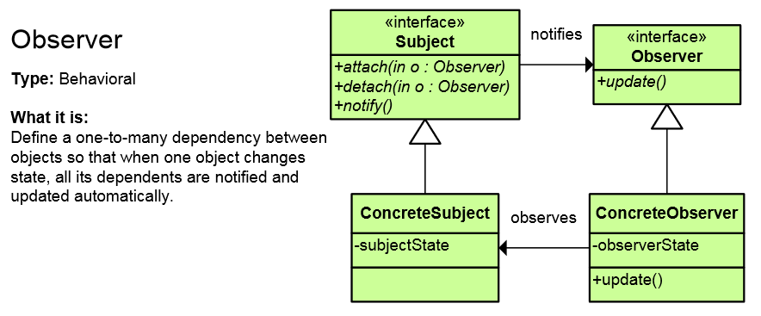
Observer Pattern
Presents interface, allowing object to communicate without any concrete knowledge about each other
Also known as Publish-Subscribe pattern
Object to inform other object about its state, without the knowledge which are these objects
In .NET Framework events and event handlers use this pattern

Slide 58
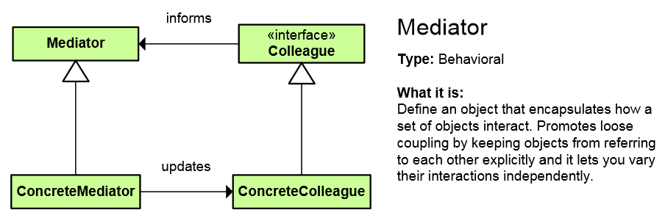
Mediator Pattern
Simplifies communication between classes
Define an object that encapsulates how a set of objects interact
Promotes loose coupling by keeping objects from referring to each other explicitly
Lets you vary their interaction independently

Slide 59
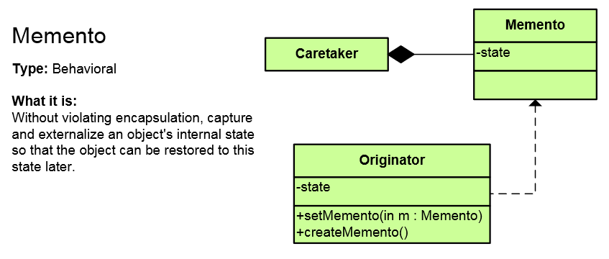
Memento Pattern
Capture and restore an object's internal state
Promote undo or rollback to full object status
A magic cookie that encapsulates a “check point” capability

Slide 60
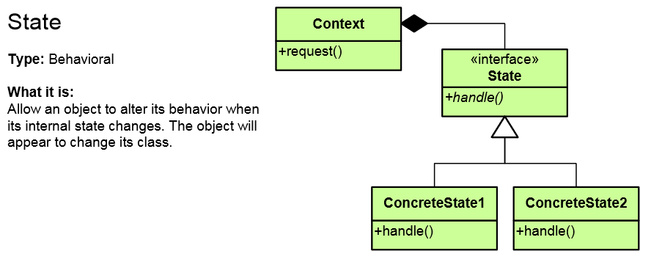
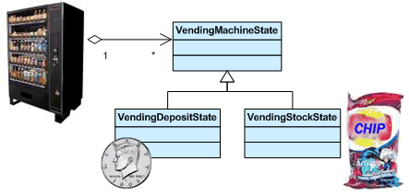
State Pattern
Alter an object's behavior when its state changes
Change behavior of the object with each state
Encapsulate the logic of each state into an object
Allow dynamic state discovery
Make unit testing easier
An object-oriented state machine

Slide 61
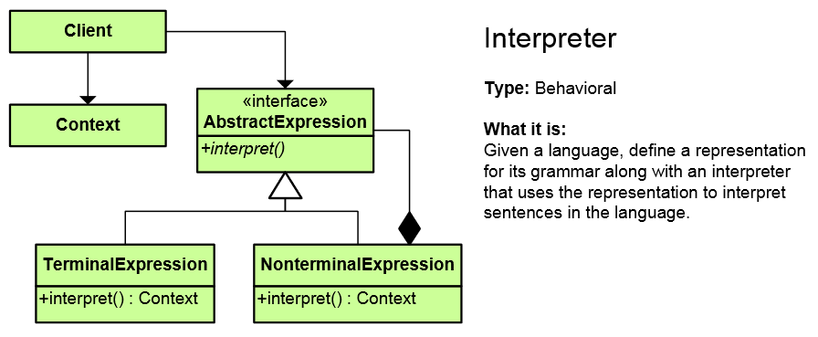
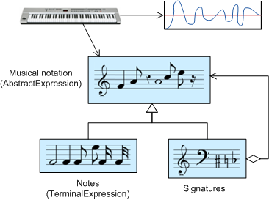
Interpreter Pattern
A way to include language (formal grammar) elements in a program
Define a representation for the grammar
Define an interpreter that uses the representation to interpret sentences in the language

Slide 62
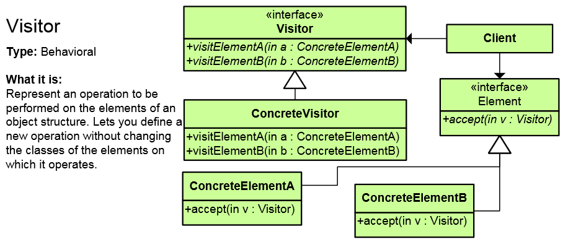

Visitor Pattern
Defines a new operation to a class without change the elements of the class
The classic technique for recovering lost type information
Do the right thing based on the type of two objects
Double dispatch

Slide 63
Other Behavioral Patterns
Null Object
Designed to act as a default value of an object
In .NET: String.Empty, EventArgs.Empty, etc.
Hierarchical visitor
Visit every node in a hierarchical data structure
Protocol stack
Scheduled-task
Single-serving visitor
Specification pattern

Slide 64

Architectural patterns

Slide 65

Client-Server Architecture
The client-server model consists of:
Server – a single machine / application that provides services to multiple clients
Could be IIS based Web server
Could be WCF based service
Could be a services in the cloud
Clients –software applications that provide UI (front-end) to access the services at the server
Could be WPF, HTML5, Silverlight, ASP.NET, …

Slide 66
The 3-Tier Architecture
The 3-tier architecture consists of the following tiers (layers):
Front-end (client layer)
Client software – provides the UI of the system
Middle tier (business layer)
Server software – provides the core system logic
Implements the business processes / services
Back-end (data layer)
Manages the data of the system (database / cloud)

Slide 67

Multi-Tier Architecture
HTML
ASP
.NET
WCF
ORM
DB

Slide 68
Model-View-Controller (MVC)
Model-View-Controller (MVC) architecture
Separates the business logic from application data and presentation
Model
Keeps the application state (data)
View
Displays the data to the user (shows UI)
Controller
Handles the interaction with the user

Slide 69

MVC and Multi-Tier Architecture
MVC does not replace the multi-tier architecture
Both are usually used together
Typical multi-tier architecture can use MVC
To separate logic, data and presentation
Controllers (Business Logic)
Views (Presentation)
Model (Data)
Data Access Logic

Slide 70
Model-View-Presenter (MVP)
Model-View-Presenter (MVP) is UI design pattern similar to MVC
Model
Keeps application data (state)
View
Presentation – displays the UI and handles UI events (keyboard, mouse, etc.)
Presenter
Presentation logic (prepares data taken from the model to be displayed in certain format)

Slide 71
Model-View-ViewModel (MVVM)
Model-View-ViewModel (MVVM) is architectural pattern for modern UI development
Invented by Microsoft for use in WPF and Silverlight
Based on MVC, MVP and Martin Fowler's Presentation Model pattern
Officially published in the Prism project (Composite Application Guidance for WPF and Silverlight)
Separates the "view layer" (state and behavior) from the rest of the application

Slide 72
MVVM Structure
Model
Keeps the application data / state representation
E.g. data access layer or ORM framework
View
UI elements of the application
Windows, forms, controls, fields, buttons, etc.
ViewModel
Data binder and converter that changes the Model information into View information
Exposes commands for binding in the Views

Slide 73

MVP vs. MVVM Patterns
MVVM is like MVP but leverages the platform's build-in bi-directional data binding mechanisms

Slide 74
SOA
Service-Oriented Architecture (SOA) is a concept for development of software systems
Using reusable building blocks (components) called "services"
Services in SOA are:
Autonomous, stateless business functions
Accept requests and return responses
Use well-defined, standard interface

Slide 75
Inversion of Control (IoC)
Inversion of Control (IoC) is an abstract principle in software design in which
The flow of control of a system is inverted compared to procedural programming
The main control of the program is inverted, moved away from you to the framework
Basic IoC principle:
Implementations typically rely on callbacks
Don't call us, we'll call you!

Slide 76
Other Design Patterns
Concurrency patterns
Active Object
Double Checked Locking pattern
Monitor Object
An object to can be safely used by many threads
Read-Write Lock pattern
Thread Pool pattern
A number of threads are created to perform a number of tasks
And many more

Slide 77
More Software Patterns
Idioms (low level, C++)
E.g. when should you define a virtual destructor?
Design (micro-architectures) [Gamma-GoF]
Architectural patterns (systems design)
Client-Server, 3-Tier / Multi-Tier
MVC (Model-View-Controller)
MVP (Model-View-Presenter)
MVVM (Model View ViewModel)
SOA (Service-Oriented Architecture) Patterns

Slide 78
Patterns in .NET Framework
Iterator pattern in foreach loops in C#
Observer pattern – events and event handlers
Adapter pattern is used in ADO.NET
Decorator: CryptoStream decorates Stream
Command in WPF and Silverlight encapsulate a request to call a method with parameters
Façade pattern used in many Win32 API based classes to hide Win32 complexity
Chain of Responsibility is similar to exceptions
String.Empty is a Null Object

Slide 79
Design Patterns
http://academy.telerik.com

Slide 80
Homework
Select 3 design patterns
Write a short description (about half page) for each of them (prefer Bulgarian language)
Describe their motivation, intent, applicability, known uses, implementation, consequences, structure, related patterns, etc.
Provide C# examples for their use
Provide a UML diagram or image of the pattern
You can download it from the Internet

Slide 81




Free Trainings @ Telerik Academy
C# Programming @ Telerik Academy
csharpfundamentals.telerik.com
Telerik Software Academy
academy.telerik.com
Telerik Academy @ Facebook
facebook.com/TelerikAcademy
Telerik Software Academy Forums
forums.academy.telerik.com

